Slide 1
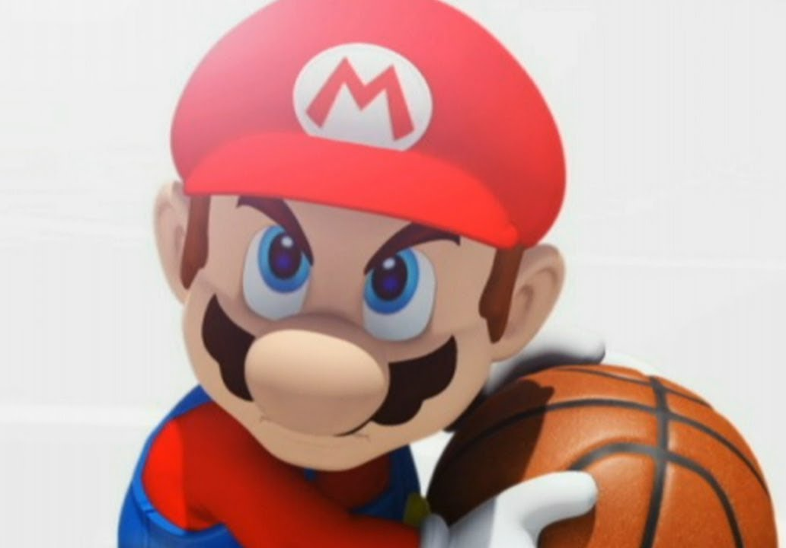

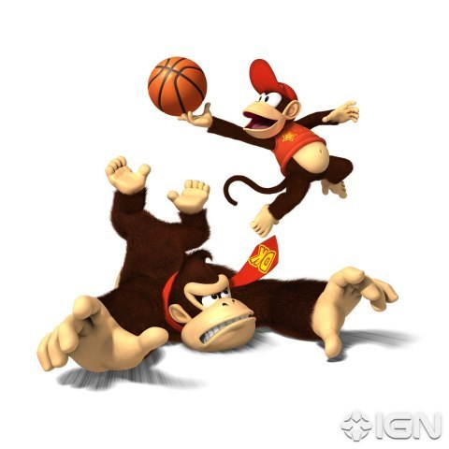
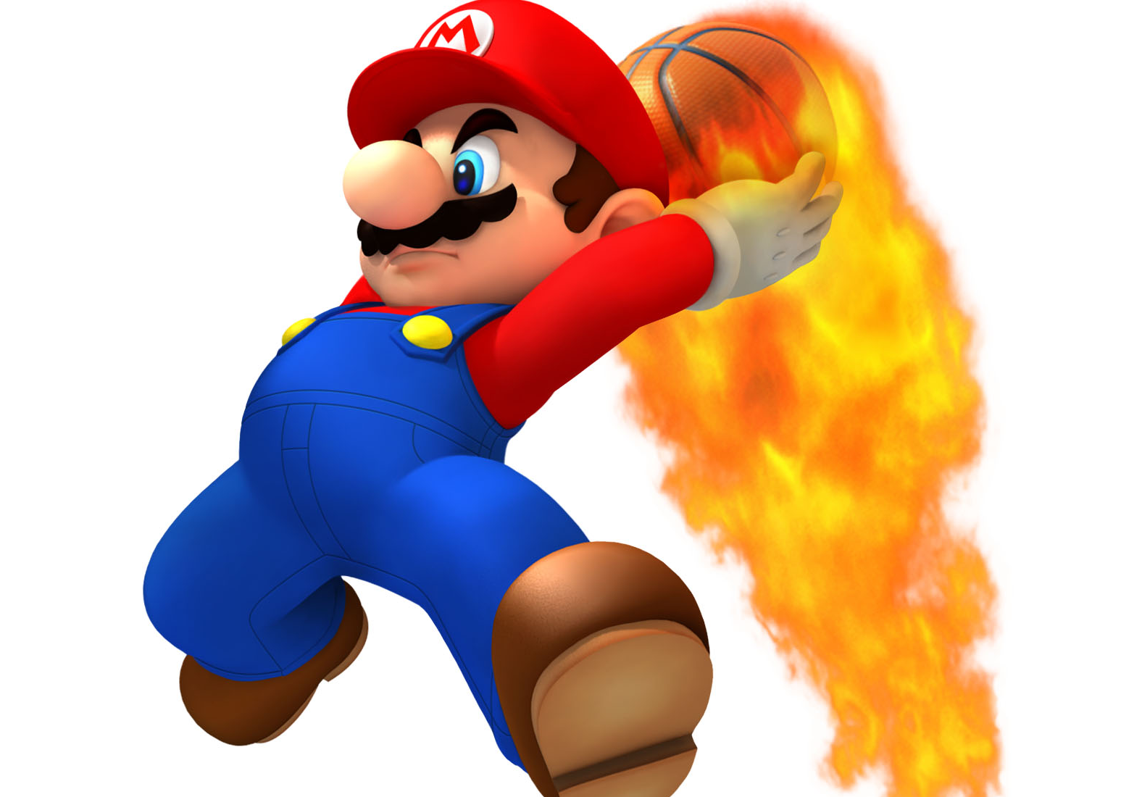
Basketball V
Produced by Dr. Mario
UNC STOR 538

Slide 2

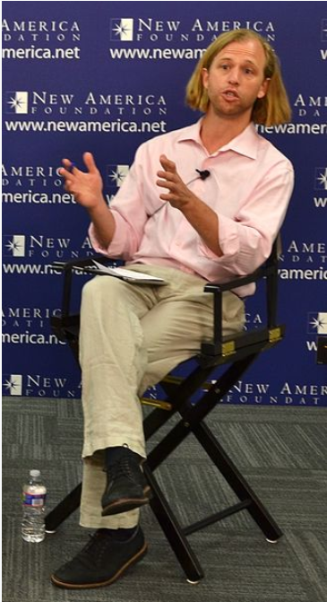
Racial Prejudice of NBA Officials
Article: Racial Discrimination Among NBA Referees
Author 1: Joseph Price from Cornell (PhD)
Author 2: Justin Wolfers from UPenn (Professor)
Claim: More Personal Fouls for Players Officiated by a Refereeing Crew of Different Race
Breakdown of Refereeing Crew
Three Officials and Four Classifications
Black Official on Black Player
White Official on White Player
White Official on Black Player
Black Official on White Player

Slide 3
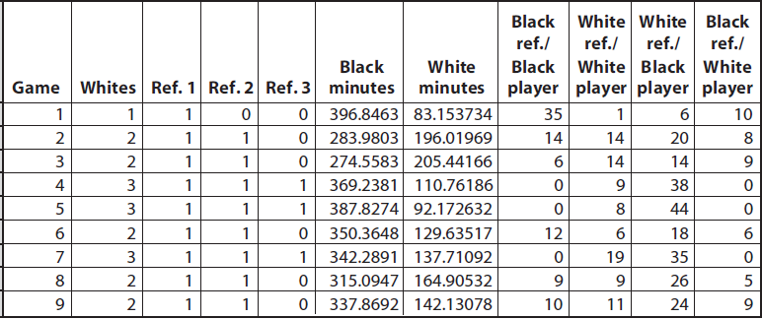
Racial Prejudice of NBA Officials
Dataset for Referee Bias

Slide 4

Racial Prejudice of NBA Officials
Fouls Per 48 Minutes
Summary Table
Estimation:
9,024 Fouls Called by Black Officials Against Black Players
310,413 Minutes for Black Players When Black Official on Court
 | White Player | Black Player
White Referee | 1.708 | 1.454
Black Referee | 1.665 | 1.423
$$Fouls Per 48 Minutes=\frac{9,024}{310,413}×48=1.423$$

Slide 5
Racial Prejudice of NBA Officials
Regression Approach of Price and Wolfer
Data Gathered
Fouls Per 48 Minutes (F)
Race of Player (R)
Percentage of Game Officials Who are White (W)
Model to Predict Fouls Per 48 Minutes
All Parameters are Statistically Significant
Possible Values for R: White=0 & Black=1
Possible Values for W: 0, 1/3, 2/3, 3/3
$$E\left[F\right]=5.1−0.763×R−0.204×W+0.182×R×W$$
Interaction

Slide 6
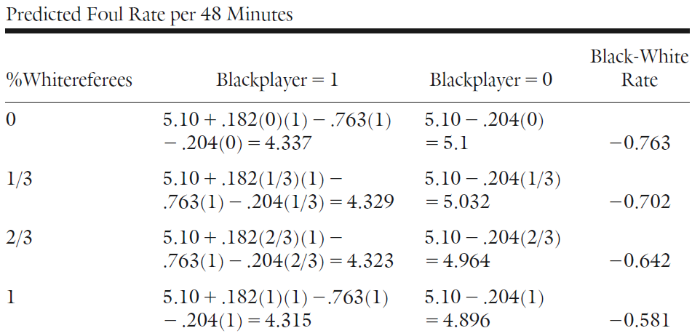
Racial Prejudice of NBA Officials
Regression Approach of Price and Wolfer
Table Showing Predicted Rates for All Scenarios

Slide 7

Fixing College Basketball Games
Justin Wolfers
Professor of Public Policy at Wharton
Claimed 5% of College Basketball Games are Fixed
Players Intentionally Play Worse (Point Shaving)
Is This Claim Defensible or is Justin Salty Because UPenn Ain’t Making it to the Tournament?
Assumptions for Point Spreads
Prediction Errors are Evenly Distributed Around 0 (Unbiased and Symmetric)
Let X = Point Spread of Favorite and E[X] = 7
Consider Intervals: A=(1,6) & B=(8,13)
We Expect That Over a Long Period…
$$P\left(X∈A\right)≈P(X∈B)$$

Slide 8
Fixing College Basketball Games
Justin’s Discovery of the Serious Conspiracy
Considered Games Where a Team was Favored by More than 12 Points (Strong Favorites) Forecast Errors Not Symmetrically Distributed
46.2% of the Time, Favorite Won by Less Points
40.7% of the Time, Favorite Won by More Points
The 5.5% Difference Due to Players Cheating?
Problem With This Conclusion
Spreads Change as People Make Bets
Therefore, Closing Spreads May not Represent the Actual Expectation of the Spread

Slide 9
Fixing College Basketball Games
General Notation
Let X = Point Spread of Favorite and E[X] = S
Consider Intervals: A=(1,S-1) & B=(S+1,2S-1)
Rebuttal by Heston and Bernhardt
Examined Strong Favorites Where the Spread Increased from the Opening Line
More Betting on the Favorite Causes this Increase Which Would Lead to a Lack of Incentive for Point Shaving
Examined Strong Favorites Where the Spread Decreased from the Opening Line
More Betting on the Underdog Causes this Decrease Which Would Lead to an Incentive for Point Shaving
$$P\left(X∈A\right)=45.15\%>39.54\%=P(X∈B)$$
$$P\left(X∈A\right)=45.12\%>39.54\%=P(X∈B)$$

Slide 10
Fixing College Basketball Games
Conclusion
Discrepancy Existed Under Both Scenarios
Indicates Another Reason For This Phenomenon
Strong Favorites May Actually Care About Winning the Game More Than They Care About Making Vegas Happy
Teams Leading By a Wide Margin May Relax the Increase in Points and Focus on Defense and Slowing the Game Down

Slide 11
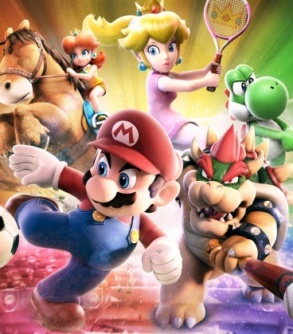
Final Inspiration
The greatest thing that happened to Cleveland is the worst thing that happened to Lebron James.
- Mahatma Mario

